Slide 1
CMPSC 100
Computational Expression

Slide 2


What happens if we delete it?

Slide 3
What happens if we delete a git folder?
Locate your previous “class-activities” repository folder.
If you can’t find it, it’s alright to follow along with the next steps.
Delete this folder.
This doesn’t do anything except delete your local copy.
The repository lives on at GitHub, and can be “cloned” again.
We’ll re-“clone” it later

Slide 4
The “World Clock”
“Computational” novel written in 2013.
Written in the Python language
The author (Nick Montfort) claims that they “wrote” the novel in 4 hours, on 27 November, 2013.
This novel was his entry in a November-based event called “NaNoGenMo,” which runs alongside “NaNoWriMo.”
During “NaNoGenMo,” authors write novel-length works from computer programs using various methods and subjects.
One novel, for example, translates famous books into over 50,000 “meows.”

Slide 5
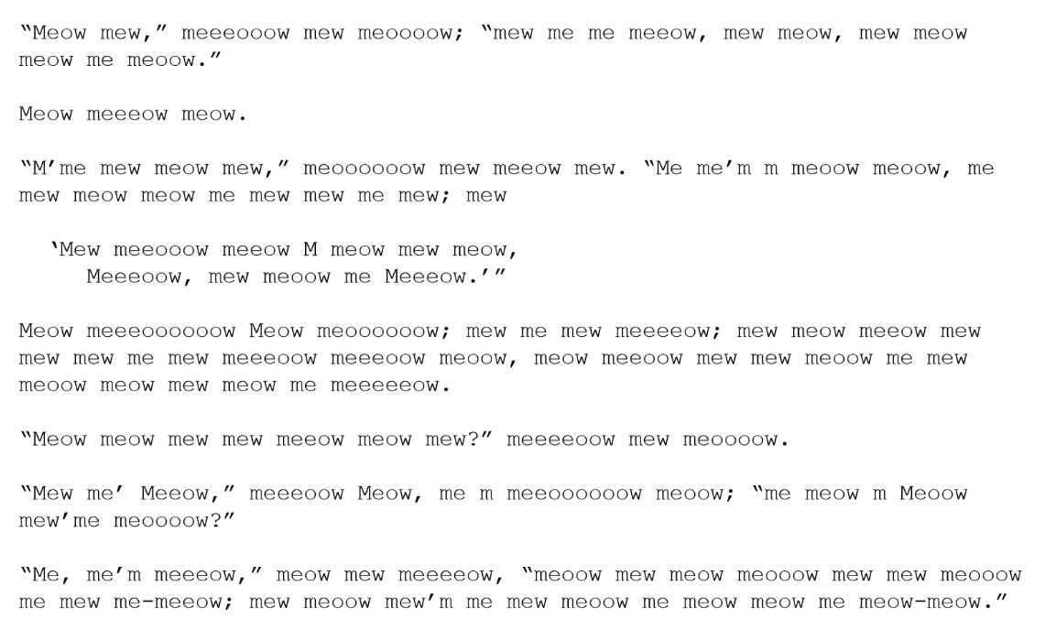
No, this was not Prof. Luman; it was Finnish developer Hugo van Kemenade (@hugovk)

Slide 6
The World Clock
Modeled on Staislaw Lem’s book One Human Minute..
“
[A] review of a book of statistical tables, a compilation that includes everything that happens to human life on the planet within any given 60 second period.
LYNN HARNETT, PORTSMOUTH HERALD

Slide 7
One Human Minute lies in its being…
synchronous with the human world, like a computer of the type that we say works in real time, a device tracking phenomena as
they occur.
STANISLAW LEM, ONE HUMAN MINUTE
“

Slide 8
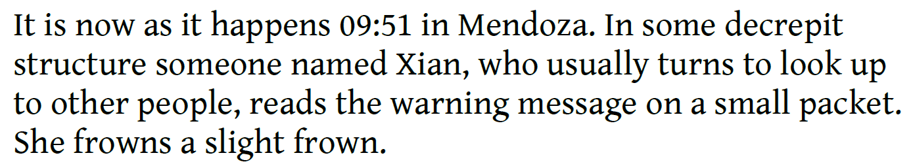
Rules
There is a formulaic computational structure. What is it?
Consider all of the grammatical pieces.
What pieces absolutely require computation to reproduce?

Slide 9
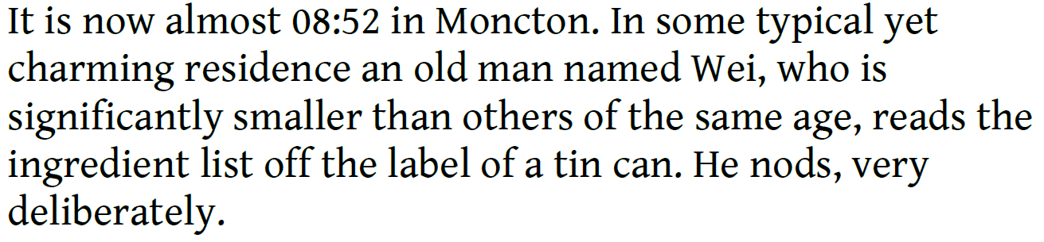

Slide 10
Let’s write our own entry
Open a terminal window
Clone the link provided in the #activities channel.
This will recreate the “class-activities” repository
“cd” to this repository’s main folder
Return to the #activities channel and copy/paste the “git remote add download” command in full into your own terminal and press the Enter key.
This will allow you to type “git pull download master” whenever I tell you there’s a content update.

Slide 11
Let’s write our own entry
“cd” to the “11-September” folder.
Read through the “Entry.java” code
We see another way to print text to a console screen.
What is this new way?
What kind of “call” does Java refer to this as?
What is the expected output?
Here, think about the difference between “println” and “print”
Where does this “method” come from? (Last class I referred to Java giving us something for “free.”)

Slide 12
Let’s write our own entry
Today, we’re also adding another piece of vocabulary: a VARIABLE
We’ll read more about this is the next chapter.
What is the variable’s name?
What do you expect it to contain?
Its contents are referred to as a “String” in Java: simply a grouping of characters and spaces.
We can often add content from strings “inline” with other text of the same type.

Slide 13
Let’s write our own entry
Adding String variables to strings is called CONCATENATION
Two examples of concatenating a variable in a “print” statement:
System.out.print(“It is now ” + time);
System.out.print(“My name is ” + name);

Slide 14
Let’s write our own entry
Fill in the requested information in the “Entry.java” file to create an entry like those in The World Clock.
When you’re finished:
javac Clock.java –d .
javac Entry.java –d .
Run your entry: java WorldClock.Entry
(The reason we run it this way is because I created these files as part of a single PACKAGE, another way of grouping and organizing files.)
(It’s called “WorldClock”: see “package WorldClock” lines)

